Slide 1

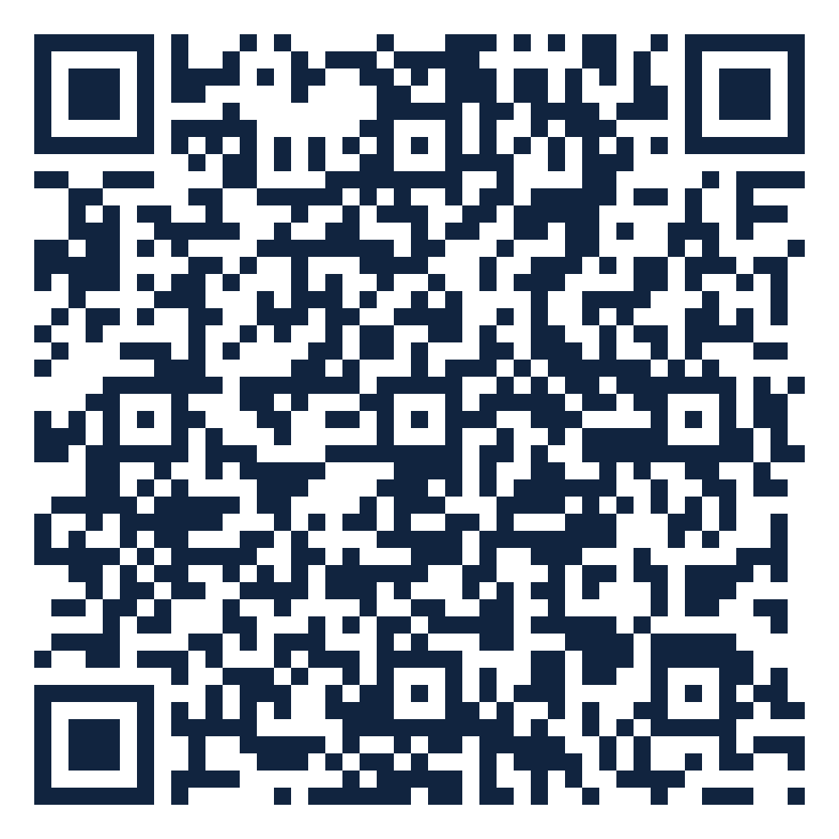
ORGANIZATIONAL TRUST QUOTIENT®
Reading team health
from everyday messages
How people talk at work → a signal of how the team is doing
Scan to open in Colab
Vernon T. Cox · Srilatha Alla
CNM Ingenuity — Data Science Bootcamp Capstone
Instructor: Robert Citek
SME: Prof. R. DelCampo — UNM Anderson
Notes:
Hi, I'm Vernon Cox, with Srilatha Alla. Our project asks a simple question: can the way a team communicates tell us how healthy the team is? We read everyday message patterns — not the words — and turn them into a signal. The QR code opens our notebook runnable in Colab. About 30 seconds.

Slide 2





PREVIEW — WHAT WE'LL COVER
The next 10 minutes
Scan · Colab
1
The problem we set out to solve
2
What OTQ looks at
3
The data — and how we score it
4
Results & the dashboard we built
5
Take-homes & what's next
02
Notes:
Tell 'em what we're gonna tell 'em. Five beats: the problem, what we look at, the data plus our scoring, results and the dashboard, then take-homes and next steps. 20 seconds.

Slide 3

THE PROBLEM
Trust is hard to see — until it's gone
Scan · Colab
The usual way: a yearly survey
DAYS BETWEEN CHECK-INS
365
Only once a year — misses problems as they build
People answer how they “should”
Takes time away from work
Teams send thousands of
messages a day — unused
Our goal: an always-on read — with no extra work
03
Notes:
The problem in plain terms. Trust decides whether people speak up early or share half-finished ideas. But we usually only check once a year, with a survey that's slow, biased, and disruptive. Meanwhile teams already produce thousands of signals a day. Our goal: use those, with no extra work.

Slide 4

WHAT OTQ LOOKS AT
From “how people talk” to “how the team is doing”
Scan · Colab
→
→
WE MEASURE
WE PREDICT
WE'RE AFTER
Engagement
Responsiveness
Trust
how much people talk & meet
how fast they reply
the thing underneath — inferred
Being honest: we measure talk and predict replies. Trust is what we believe sits underneath — we don't claim to measure it directly.
04
Notes:
What we actually look at — and our reviewer's key point. We measure engagement (how much people talk and meet), we predict responsiveness (how fast they reply), and trust is the thing underneath that we're really after. We're careful not to overclaim: we don't say we measure trust directly.

Slide 5





THE DATA · WHERE IT COMES FROM
Three everyday tools, one combined table
Scan · Colab
→
Slack
Teams
Outlook
106 events
in one table
56 chat messages
30 meetings
20 calendar invites
Practice data: the “Apostles” dataset
No real company yet — so we built safe stand-in data from Bible figures (the apostles). Same shape as real Slack / Teams / Outlook exports, so the code is ready for the real thing.
05
Notes:
Where the data comes from. We pull from the three tools people already use — Slack, Teams, Outlook — and merge them into one table of 106 events. Since we don't have a real company's data yet, we built safe practice data from Bible figures, the apostles, in exactly the same format a real export would have.

Slide 6

THE DATA · WHAT'S IN IT
Each row is one interaction — counts, not words
Scan · Colab
Source | Type | Who | Channel | Min | People | Score
Teams | meeting | Peter | council | 60 | 12 | 30.9
Slack | chat | Paul | epistles | 0 | 2 | 11.0
Outlook | meeting | James | assembly | 90 | 8 | 30.5
Slack | chat | John | acts | 0 | 4 | 12.5
What we keep
Who & where
How long
How many people
A reply-speed clue
Sample rows from the combined table. Names/channels are labels in the data — never message content.
106
3
8
events
sources
fields each
06
Notes:
This is the heart of the data. Each row is a single interaction with a few plain facts: which tool, what type, who, where, how long, how many people, and a reply-speed clue. Crucially, we keep counts and timing — never the contents of any message. 106 events, 3 sources, about 8 fields each.

Slide 7

THE DATA · HOW WE SCORE IT
Give every interaction a score
Scan · Colab
Bigger score = more engagement. Meetings count more than emails; longer and more people count more.
Score one event
Start: type of interaction
Add: how long it ran
Add: how many people
Add up each day
Total score & # of events
Avg people & length
How much was written
07
Notes:
How we turn interactions into numbers. Every event gets an engagement score: start with the type — meetings count most, email least — then add a little for how long it ran and how many people were involved. Then we add everything up per day to get daily team numbers. All the rules are simple and visible.

Slide 8

UNDER THE HOOD · THE CODE
From rule to score, in real code
Scan · Colab
otq_scoring.py
fit_model.py
def otq_event_units(event_type, duration, people):
t = event_type.lower()
if "meeting" in t: base = 24.5 # weighs most
elif "chat" in t: base = 9.5
elif "call" in t: base = 8.5
elif "email" in t: base = 6.0
else: base = 5.0
dur = min(duration, 120) / 60.0 # +0 to 2
reach = log(max(people,1), 2) * 1.5
return base + dur + reach
features = ["log_total_eu",
"log_total_events", "avg_participants",
"avg_duration", "log_total_text"]
# alpha tuned by GridSearchCV (5-fold)
model = Ridge(alpha=best_alpha)
model.fit(X_train, y_train)
r2 = r2_score(y_test, model.predict(X_test))
# negative coef -> more talk, faster reply
In plain English
In plain English
Each interaction earns points: a meeting starts at 24.5, an email at 6. Add a little for how long it ran and how many people joined. Bigger number = more engagement.
We give the model five daily numbers and let it learn the link to reply speed, then test it on days it never saw. A minus sign means: more engagement → faster replies.
08
Notes:
A quick peek under the hood. On the left, the scoring rule we just described, exactly as it runs: a base by type, a small duration bonus, and a log-scaled reach. On the right, the model: five daily features, a Ridge regression with its strength tuned by grid search, then we score it on days it never saw. You can scan the QR to run all of it.

Slide 9
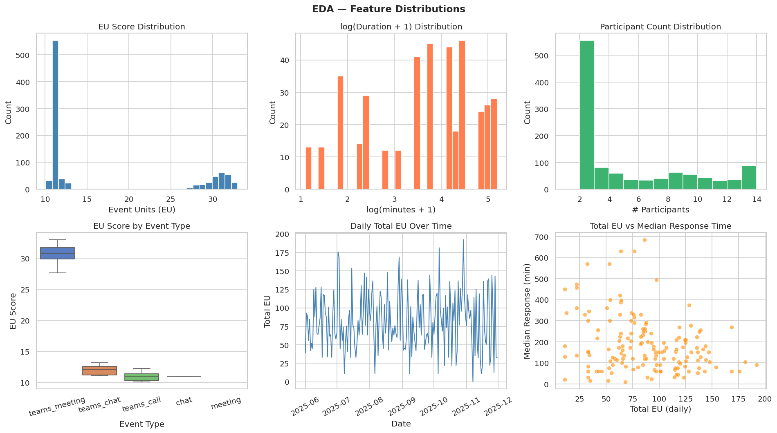
THE DATA · A FIRST LOOK
What the real numbers look like
Scan · Colab
Straight from the notebook: how scores, durations, and team size are distributed — and engagement vs. response time.
09
Notes:
This is the real exploratory view from the notebook. Most events are short chats with a couple of people; meetings are rarer but score much higher. The bottom-right panel is the one to watch — total daily engagement against response time — which is the relationship the model goes on to learn.

Slide 10


THE MODEL
A steady model that connects the dots
Scan · Colab
What it does
How we checked it
Learns: engagement → reply speed
Our clues overlap — needs to stay steady
Ridge regression keeps it stable & readable
Compared against other models
Tuned the settings carefully
Tested on days it never saw
Ranked which clues matter most
10
Notes:
Our model in plain terms. It learns the link between engagement and reply speed. Because our clues overlap a lot, we used Ridge regression — a model built to stay steady and stay readable when that happens. And we didn't trust one run: we compared other models, tuned settings, tested on days it had never seen, and ranked which clues mattered most.

Slide 11
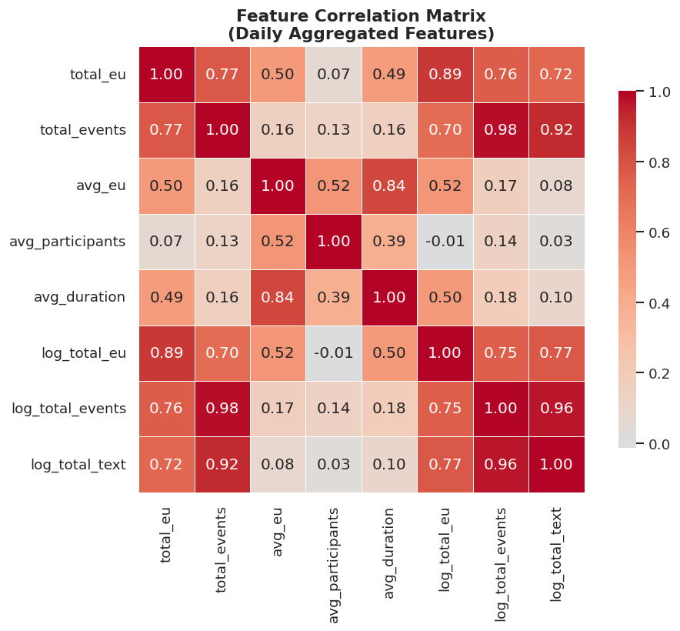
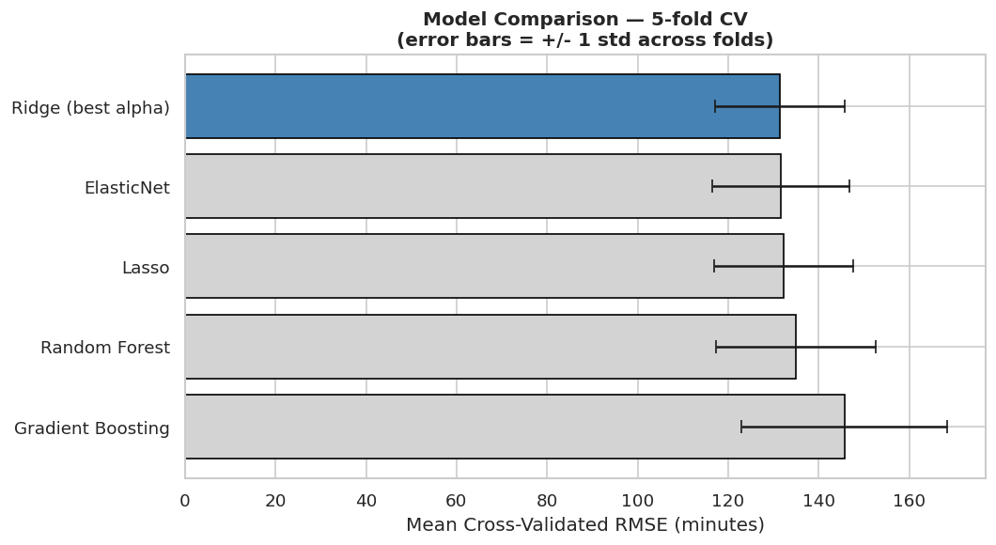
THE MODEL · CHECKS
Why a steady model — and how we know
Scan · Colab
Clues overlap (e.g. events 0.98) — so we need a steady model
Ridge had the lowest error of five model families
11
Notes:
Two checks, real output. Left: the features genuinely overlap — total events and its log are correlated 0.98 — which is exactly the situation Ridge is built for. Right: under the same 5-fold cross-validation, Ridge had the lowest error of the five model families we tried, so it's not just convenient, it's the best of the bunch.

Slide 12
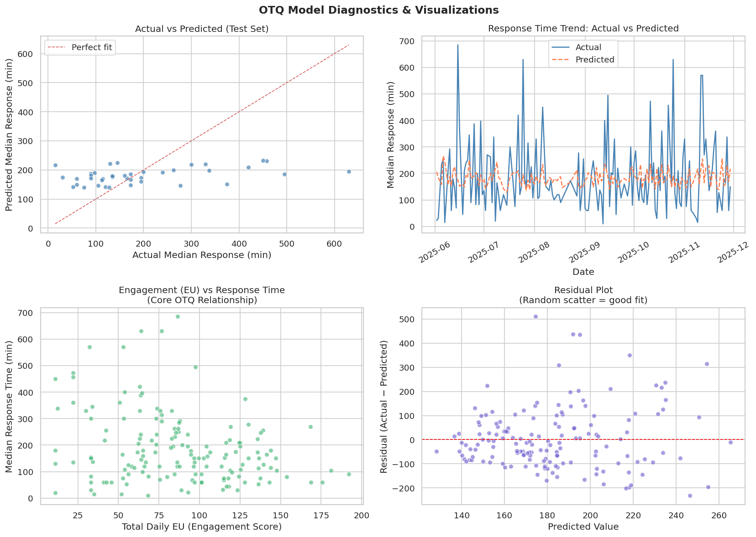
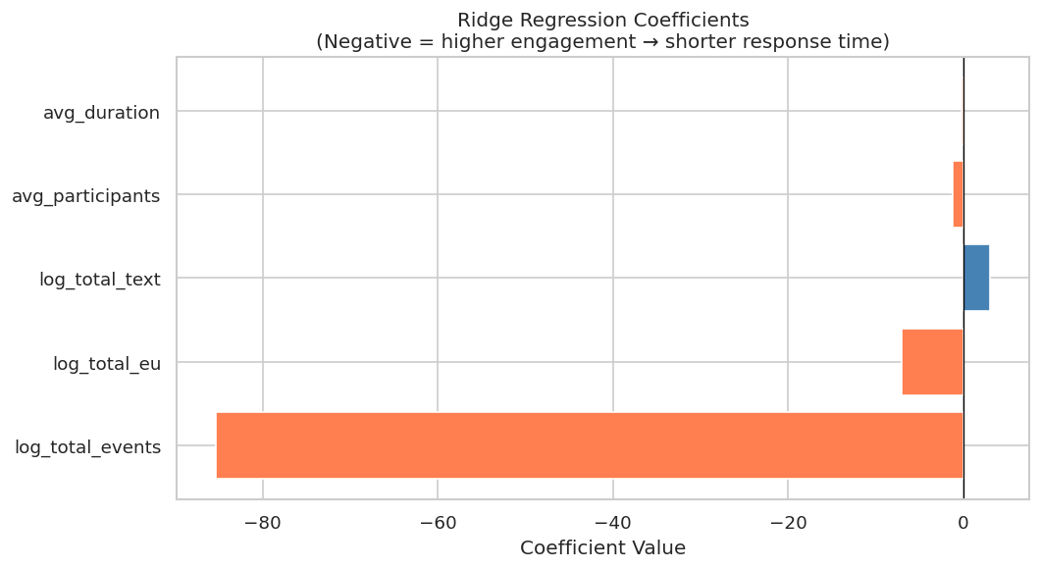
RESULTS · REAL MODEL OUTPUT
More engagement → faster replies
Scan · Colab
THE HEADLINE
More engaged → faster replies — the negative coefficients confirm it.
Real model output on the practice (Apostles) dataset — magnitudes will shift with real exports.
Model diagnostics from the notebook
12
Notes:
Now the real results. The four diagnostic panels show predictions tracking actuals, the response-time trend, the core engagement-versus-response relationship, and a residual plot with no obvious pattern — a good sign. The coefficient chart is the headline in one picture: the engagement features are negative, meaning more engagement predicts shorter response times, exactly as hypothesized. This is real model output, run on the synthetic practice data, so the direction holds but the exact magnitudes will move with real exports.

Slide 13
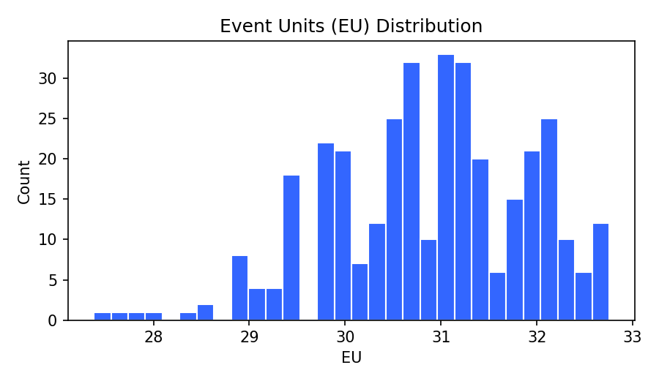
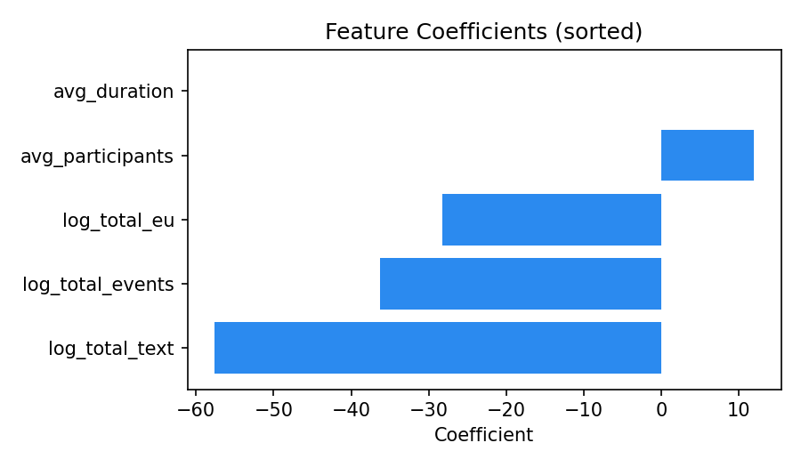
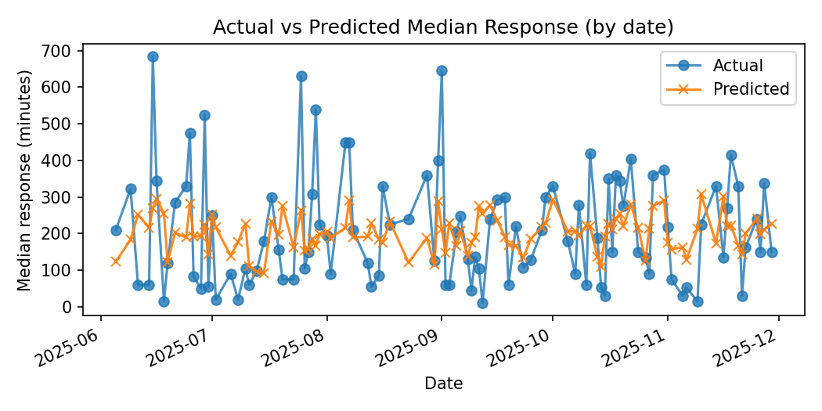
WHAT WE BUILT · LIVE RESULT
Drop in a file → real results
Scan · Colab
organizationaltrustquotient.com
✓ outlook_apostles_All.csv
0.14
127 min
350
103
Test R²
avg error (MAE)
events read
days modeled
Live run on a real Outlook export — the tool reads the file, scores engagement, and returns these metrics and charts. Directionally right (more engagement → shorter replies); accuracy climbs with multi-source data.
13
Notes:
This is the website, run for real. We dropped in a single Outlook export — 350 calendar events — and the tool did everything: read and scored the file, built daily features, fit the model, and returned these results. The four numbers are real: it modeled 103 days, with an average error around two hours on a noisy proxy. The three charts are the live output — engagement scores, the feature coefficients (engagement is negative, so more engagement means faster replies), and actual-versus-predicted over time. Someone with no coding background gets all of this from one upload. With Slack and Teams added alongside Outlook, accuracy improves further.

Slide 14


TAKE-HOME POINTS
What to remember
Scan · Colab
Always-on beats once a year
Talk predicts replies
a live read, not an annual survey
more engaged teams answer faster
We're honest about it
Private by design
we measure talk, not trust itself — yet
counts & timing only, no message content
14
Notes:
Tell 'em what you told 'em. Four take-homes: always-on beats once a year; how people talk predicts how fast they reply; we're honest that we measure talk, not trust itself yet; and it's private by design — counts and timing only, never message content. If they remember one slide, this is it.

Slide 15


WHAT'S NEXT
Next steps & questions
Where we go from here
Questions?
Check our score against a trusted trust survey
Use a real company's data
Give each team & person their own score
Track real outcomes (deadlines, tickets)
Vernon T. Cox · Srilatha Alla
Instructor: Robert Citek — CNM Ingenuity
SME: Prof. R. DelCampo — UNM Anderson
Scan to open in Colab
15
Notes:
What's next and questions. The big next step is checking our score against a trusted, validated trust survey on a real team — that's what would let us truly say 'trust.' Then real company data, scores per team and person, and tracking real outcomes. The QR code opens the notebook in Colab. Thank the instructor and SME, and open the floor.

